Slide 1
S6 MCA
PROJECT
PRESENTATION

Slide 2

S6 MCA PROJECT PRESENTATION

Slide 4
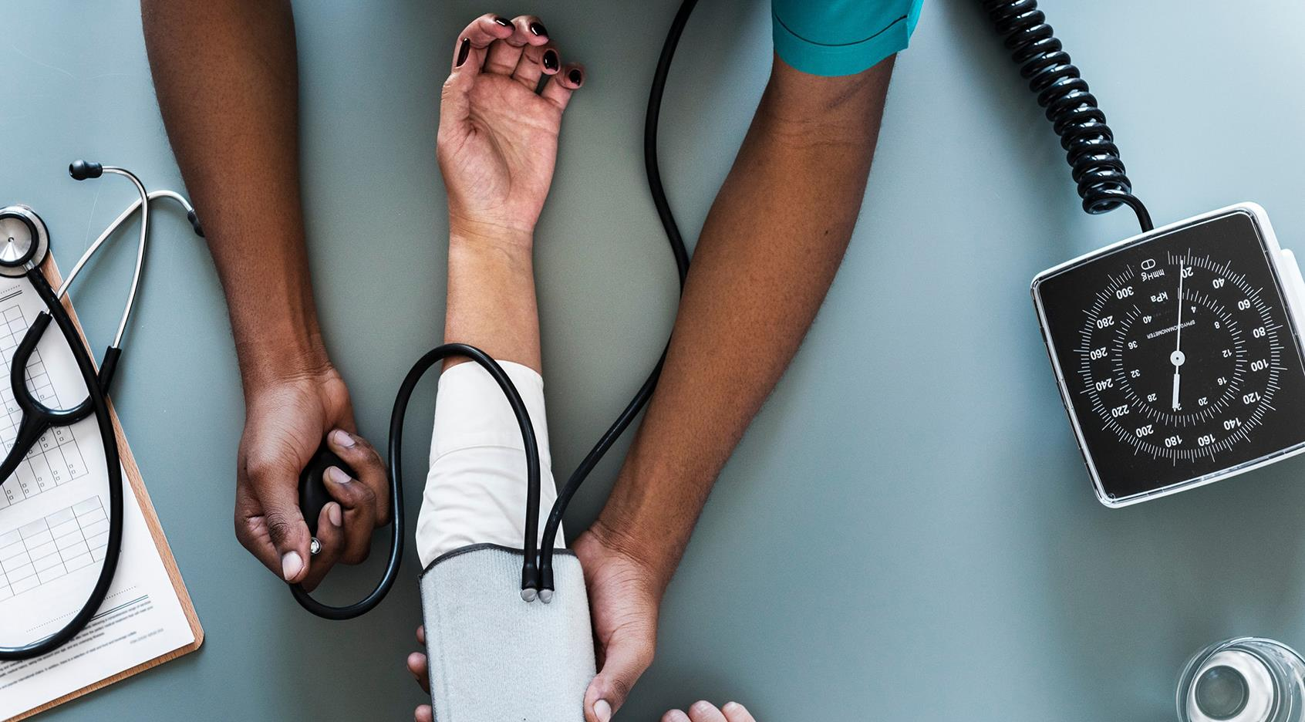
Introduction
Existing System and drawbacks
Proposed System and advantages
Block Diagram
Hardware Requirements
Software Requirements
UML Diagram
Program Design
IoT Healthcare Applications
Conclusion
Future Enhancement
AGENDA/TOPICS

Slide 5
S6 MCA PROJECT PRESENTATION

Slide 6
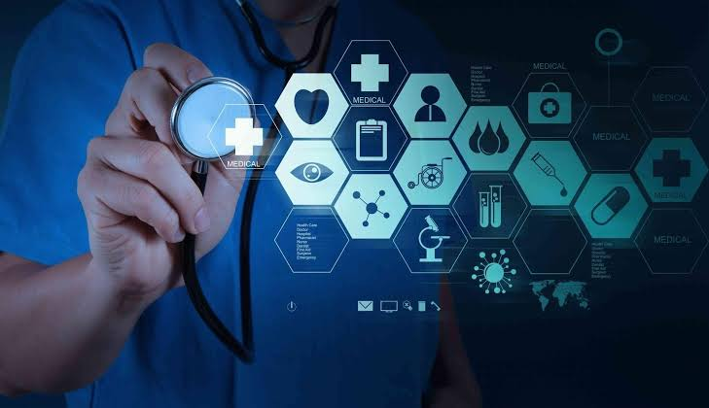
A SECURE IoT BASED MODERN HEALTHCARE SYSTEM USING BODY SENSOR NETWORK
Internal Guide:Prof. Anjana J
Submitted By
Lekshmi S R
LLMC17MCA020
S6 MCA,LMST

Slide 7
AGENDA/TOPICS
Introduction
Existing System and drawbacks
Proposed System and advantages
Block Diagram
Hardware Requirements
Software Requirements
UML Diagram
Program Design
IoT Healthcare system Architecture
IoT Healthcare Applications
Conclusion
Future Enhancement

Slide 8
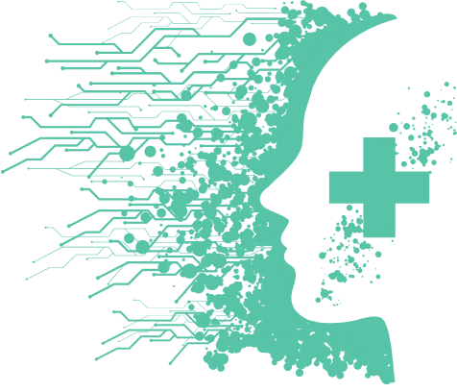
INTRODUCTION
In the present-day scenario, we find a large number of elderly people staying alone in flats or at isolated places.
Recent research indicates that about 80% of aged people above the age of 65 are suffering from at least one chronic life style disease.
IOT based modern healthcare is intended to meet the urgent medical needs of patients particularly isolated senior citizens.
IOT enables to extend the concept to internet and make it more feasible by providing seamless interactions with different types of devices.
The proposed modern IOT based BSN care envisages provision of affordable and timely healthcare at their door step and thus improving the quality of life.

Slide 9
OBJECTIVE & SCOPE
The information is passed to the cloud server of the medical team on real time. The medical team then take appropriate action to save the patient.
Objective of the project is to make affordable, fully secure and timely healthcare to all particularly elderly. The system make use of the body sensor networks which with the help of iot & various body sensors measures the health parameters of the patient on Realtime.
IOT based modern healthcare system is primarily intended to take care of the health aspects of older people staying alone. The system envisages to real time monitoring of the health parameters of dependent patients and provide timely and quality healthcare to them.

Slide 10
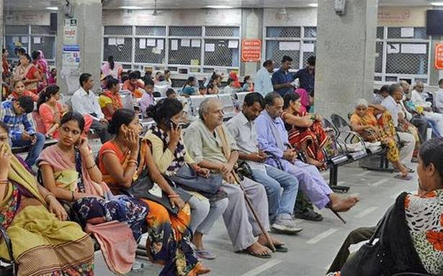
EXISTING SYSTEM
At present a patient has to travel to the nearest hospital for treatment. To see a doctor, he has to wait there for his turn. Doctor on examination of basic medical parameters prescribe medicines or ask for further investigation at the lab.
After that patient if required will be admitted for in patient treatment or will be disposed off as an out patient with necessary medicines. This process is time and effort consuming and is expensive. Moreover, in case of a medical emergency it will take time to reach a doctor/hospital.
In many such emergencies a patient by the time he reaches the hospital is dead. There are many such case of “brought dead” in our present scenario.
Modern healthcare system with the advent of IOT is able to provide BSN CARE and thus saving many lives. It is a boon to all patients particularly old people staying alone at isolated places.

Slide 11
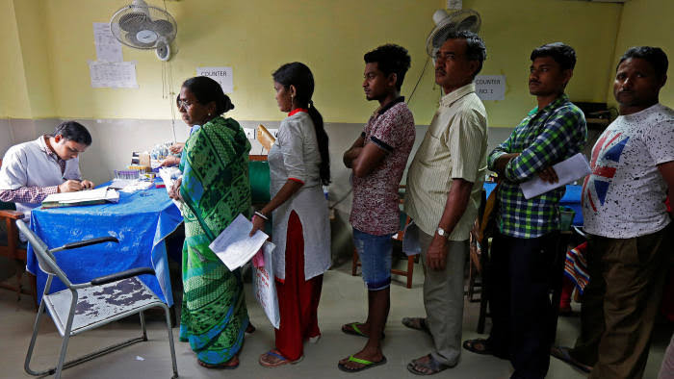
DRAWBACKS OF EXISTING SYSTEM
Existing System is inefficient.
It is very tedious and time consuming.
Lack of safety and security.
Complexity.
More human efforts.
Implementation Issues.
High Expenses.

Slide 12
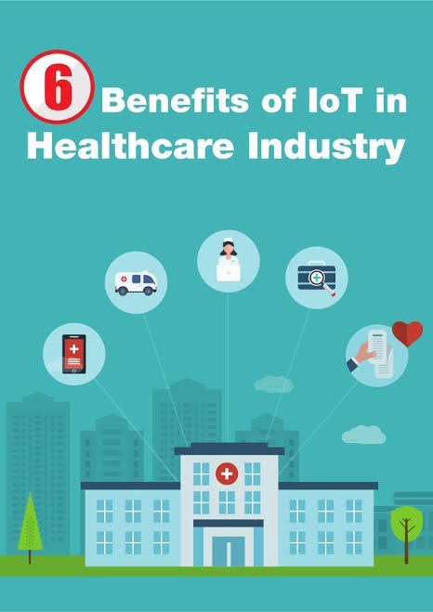
ADVANTAGES OF PROPOSED SYSTEM
Real time monitoring of health parameter.
System is safe and secure.
User Friendly.
Chronic disorders identified at primary stage itself by doctors for better decision making.
Future expansion is possible.

Slide 13
HARDWARE REQUIREMENTS
NODE MCU ESP8266 1.0 Wi-Fi Module
DHT11 Temperature sensor
Heart beat pulse sensor Amped

Slide 14
BLOCK DIAGRAM
DESCRIPTION
Sensors output of the sensors worn by the patient namely Temperature sensor, Heart beat pulse sensor, oxygen level and pulse rate sensor are fed to the NODE MCU. These sensor data are uploaded to Thingspeak using NODE MCU. Blynk server then forward the coded data to Healthcare server. The data so received is analysed and interpreted by the healthcare server. Healthcare server then feed the data to the concerned care giver or physician. It also simultaneously feed the data to emergency services or medical researcher. Healthcare giver and emergency services take appropriate action to treat the patient and also information is passed on to family or friends. The whole action is taking place on real time and hence no valuable time is lost in providing necessary treatment to the patient.

Slide 15
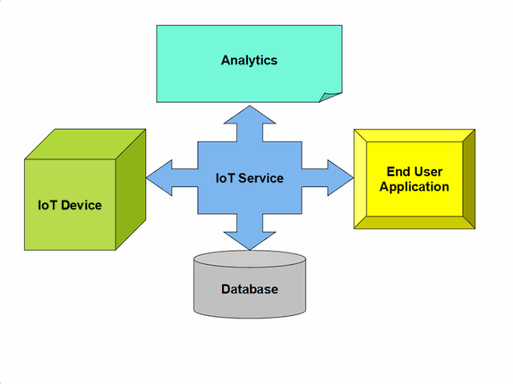
THINGSPEAK
Thingspeak is an IoT analytics platform service that allows you to aggregate, visualize and analyse live data streams in the cloud. Thingspeak provides instant visualizations of data posted by your devices to Thingspeak. With the ability to execute MATLAB code in Thingspeak you can perform online analysis and processing of the data as it comes in. Thingspeak is often used for prototyping and proof of concept IoT systems that require analytics.
Thingspeak key Features:
Easily configure devices to send data to Thingspeak using popular IoT protocols.
Visualize your sensor data in real-time.
Aggregate data on-demand from third-party sources.
Use the power of MATLAB to make sense of your IoT data.
Run your IoT analytics automatically based on schedules or events.
Prototype and build IoT systems without setting up servers or developing web software.
Automatically act on your data and communicate using third-party services like Twilio or Twitter.

Slide 16
BLYNK APPLICATION
Open Source Android App (Blynk)-: Blynk is an open source android app which is designed and developed in order to control the hardware via internet of things (IOT). This digitally displays sensor data, it can accumulate and visualize the data. Plus, it can also do other parameters such as:
Blynk App: This app gives us to create amazing interfaces for a project using multiple widgets which is an in-build app.
Blynk server: It acts as an interface between the smartphone and hardware which is responsible for the communication. We can also use blynk cloud or compile our private blynk server. It’s an open source that can control any number of devices plus can also be launched on Raspberry pi.
Blynk Libraries: For all the standard hardware platforms, supports communication with the sensor and the complete progression of incoming and outgoing instructions.

Slide 17
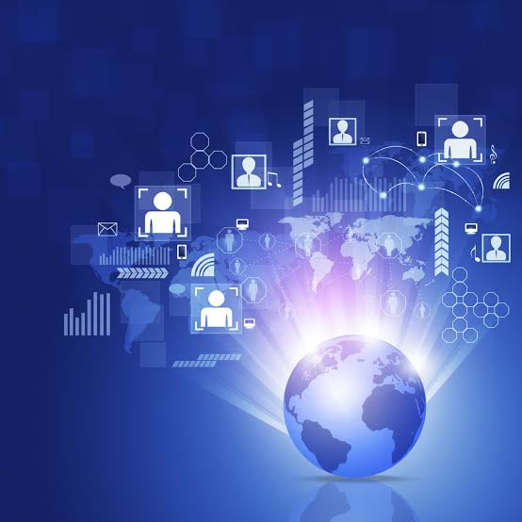
CONCLUSION
IOT based BSN-CARE healthcare system is undoubtedly going to revolutionize the existing conventional healthcare practices of the world. Formation of long queues in hospitals and in front of renowned doctors for specialist consultation etc. will soon be a thing of the past. Modern IOT based BSN healthcare system envisages provision of quality and timely healthcare at your door step based on data received on real time at the exclusive healthcare network. More over global consultation of expert renowned specialist doctors will be just a click away when fully developed worldwide.Further BSN healthcare will be a boon to slum dwellers as quality and affordable treatment can be provided to them on real time at their door step. BSN healthcare is the ideal way of treatment for all during spread of pandemic like corona virus.

Slide 18
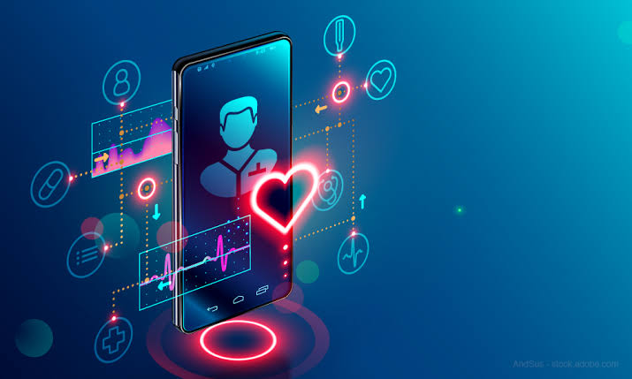
FUTURE ENHANCEMENT
The system can be enhanced to cover in remote villages where IOT can be gainfully utilised.
Body sensors in due course of time will be employing most modern technologies to minimise or make the radiations negligible.
Since internet and mobile network has conquered the whole world making the whole world a global village IOT based BSN healthcare can be extended to benefit the whole global population.
IOT based BSN healthcare will revolutise the field of medical care in due course of time benefitting the whole world.
Once fully developed and fully integrated consultation of an expert specialist anywhere in the world will be just a click away from you.

Slide 19

Thank You

